Slide 1
Notes:
Good day everybody, My Name is Davy Smets
hope you've had the chance to see some great sessions
For the speakers, may the demo gods be in your favor
Thank you for the collabdays teams for hosting this event
Our local MVP Rick is helping with organising the event
Join us after the session in the Discord channel if you have an questions

Slide 2

About Advantive
Innovative IT Partner
Microsoft technology
60 enthusiastic colleagues
Digital transformation and Cloud accelerate partner
Maximize employee experience
Belgium and The Netherlands
Notes:
- We try to maximize the employee experience

Slide 3
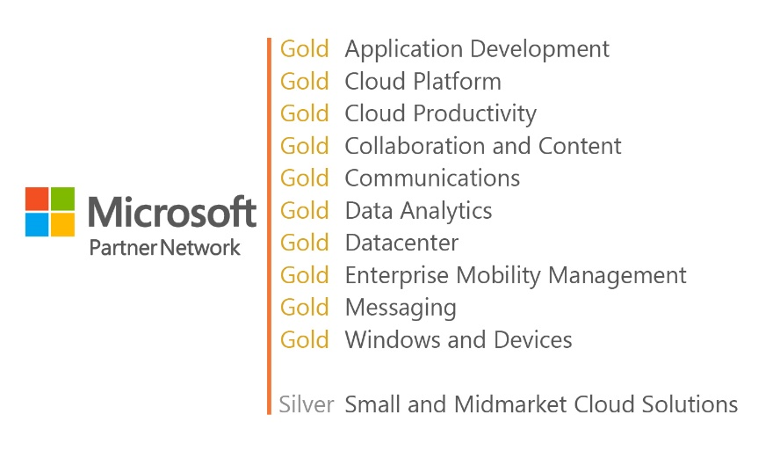
About Advantive

Slide 4

We live with our head in the Cloud and we keep our feet firmly on the ground
PASSION • PLEASURE • PROFFESIONAL
Notes:
We turn our passion and our pleasure in to our work ;-)
And if you want to join us just send an email to work@advantive.be

Slide 5

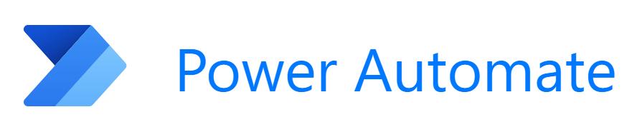
So let’s us talk about…
Data Loss Prevention for Power Platform (New stuff).

Slide 6
Introduction
Challenges
Recap: How does this work?
Connectors
Environments
DLP policies
New feature: Connection Action control
New feature: EndPoint filtering
Our experiences

Slide 7

Security Challenges
Make sure users don’t leak data to 3rd party connectors
Prevent Shadow IT
Make sure Highly sensitive data stays in the company
Make sure people don’t break stuff
This Photo by Unknown Author is licensed under CC BY

Slide 8


Slide 9
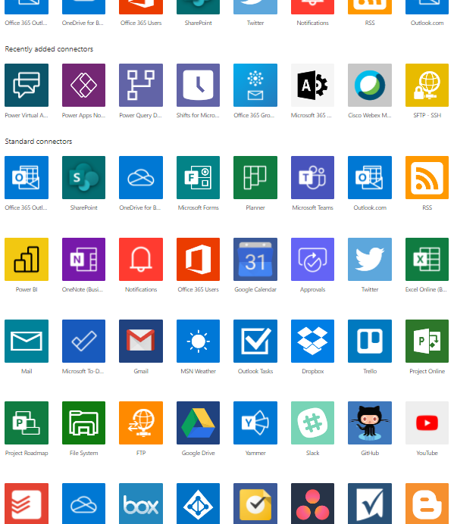
Connectors
Over 500+ connectors
Available for Power Automate and Power Apps

Slide 10
Environments
Shared across PowerApps/PowerAutomate
Teams can also create Power Platform environments (Project Oakdale). These are also effected by DLP policies.
You can apply a DLP policy to an environment. So different environments can have different DLP policies. (e.g. Human resources vs communication department).

Slide 11



Configuring a DLP policy
You have to divide the connectors in these three groups and apply them to an environment.
Business | Non-Business | Blocked
- These can’t be used with connectors in the non-Business group. | - These can’t be used with the Business group | - These can’t be used. Some standard Microsoft apps can’t be blocked.

Slide 12
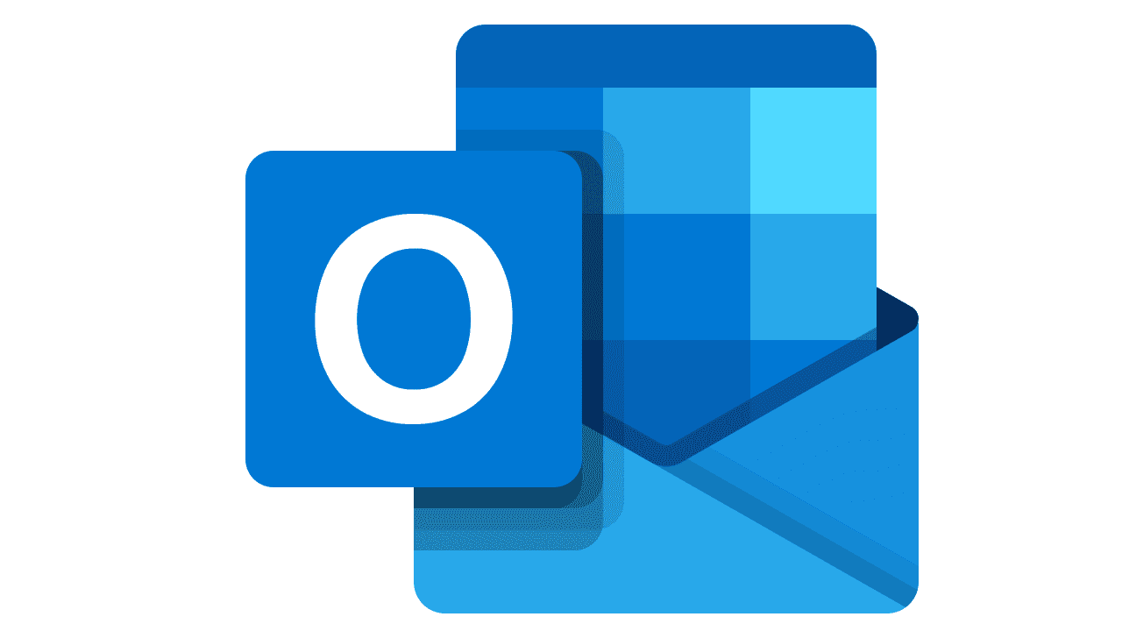
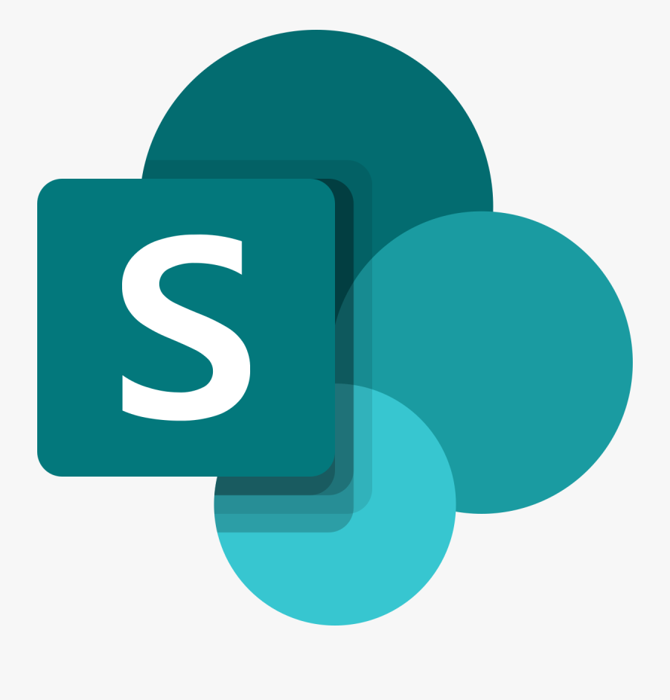
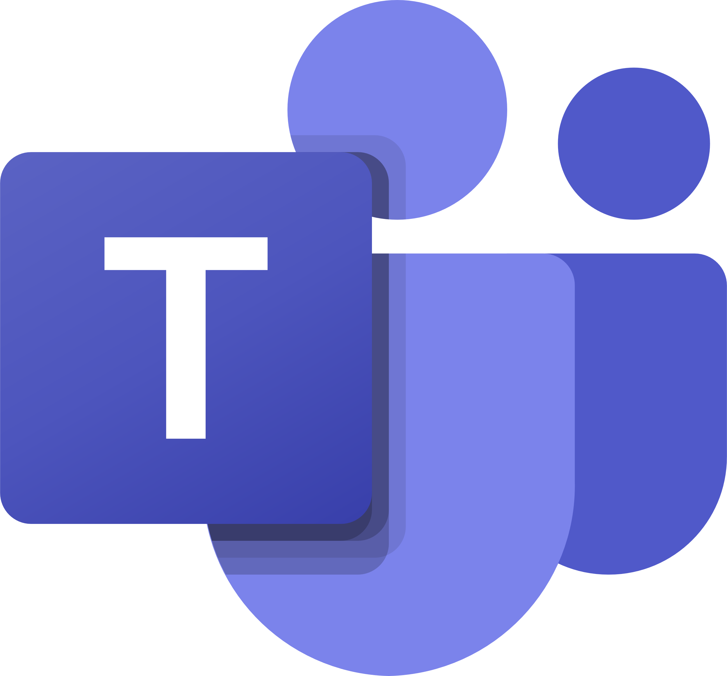

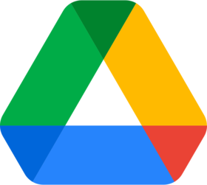

Configuring a DLP policy
Example.
Business | Non-Business | Blocked
Outlook + SharePoint = OK
Gmail + Google drive = OK
Gmail + SharePoint = NOK
Teams + Twitter = NOK

Slide 13
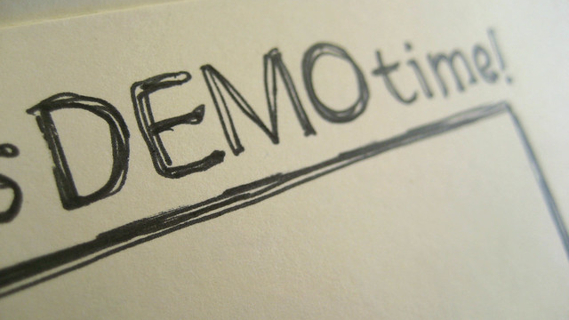

Slide 14

So, What’s new?

Slide 15
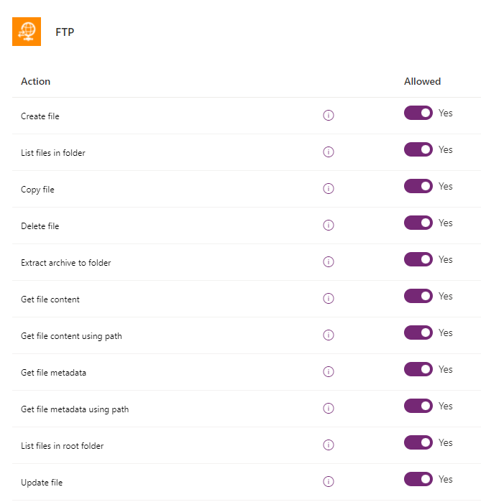
Granular Data Loss prevention
No longer makes blocking connectors a Yes or No story.
You can block actions instead of blocking entire connections
For eg: You can get data from social media platforms for marketing purposes, but still block the upload of data.
Not clear in the overview.

Slide 17
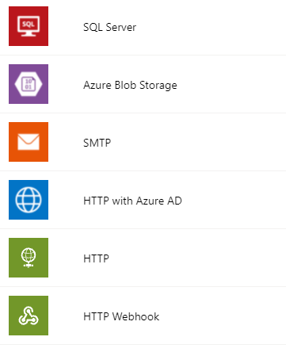
Configurable Endpoints
List of connectors that is often blocked
Now a possibility to connect to certain endpoint.
E.g. you can give people the possibility to send HTTP request to Microsoft but not to other api’s

Slide 19
Our experience
OOB experience doesn’t tell you wich apps will be impacted. (Center of excellence toolkit can help).
Communicate to your Champions/Business users
With new features DLP is not just Yes or No
Watch out you don’t lose track of your changes

Slide 20

Thank you for listening
Loves to experiment with Power Apps / Flow / SharePoint
Loves Lego
Loves Beer and great food

Slide 21

Questions

